Slide 1
Spark GraphX

Slide 2
What is GraphX?
GraphX is a component of Apache Spark for graph-parallel computations. It lets you model and analyze relationships between entities (nodes) using graphs, combining the power of:
Graph processing
Data-parallel processing (RDDs)
Example Graph:
Think of a social network:
People = Vertices (nodes)
Friendships = Edges (connections)

Slide 3
GraphX is a component of Apache Spark that lets you work with graphs (data with relationships) in a distributed way.
A graph has:
Vertices (nodes) → entities (e.g., users, web pages)
Edges → relationships (e.g., friendships, links)
Why use GraphX?
Handles large-scale graph data
Integrates with Spark (you can mix graph + SQL + ML)
Supports parallel processing

Slide 4
Why Use GraphX?
With GraphX, you can:
Analyze social networks
Model recommendation systems
Detect fraud or anomalies
Analyze web links or traffic flow

Slide 5
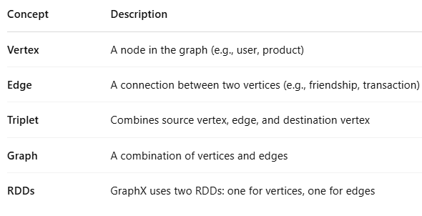
GraphX Core Concepts

Slide 6
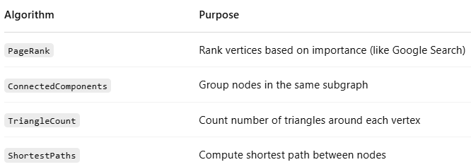
Graph Algorithms in GraphX

Slide 7
Core Concepts
1. Graph
A graph = vertices + edges
Programs in scala
Graph(verticesRDD, edgesRDD)
2. Vertices (Nodes)
Each vertex has:
ID (Long)
Property (data)
Example:
val vertices = sc.parallelize(Array( (1L, "Alice"), (2L, "Bob"), (3L, "Charlie") ))
3. Edges
Each edge has:
Source ID
Destination ID
Property
Example:
val edges = sc.parallelize(Array( Edge(1L, 2L, "friend"), Edge(2L, 3L, "follow") ))
4. Create Graph
val graph = Graph(vertices, edges)

Slide 8
Basic Operations
4. Filter
Filter vertices
graph.vertices.filter { case (id, name) => name != "Bob" }
5. Triplets
Triplets = (source vertex, edge, destination vertex)
graph.triplets.collect()
Useful for analyzing relationships.
1. View Vertices
graph.vertices.collect()
2. View Edges
graph.edges.collect()
3. Map Operations
Modify vertex data
val newGraph = graph.mapVertices((id, name) => name.toUpperCase)

Slide 9
Common Algorithms in GraphX
GraphX includes built-in graph algorithms:
1. PageRank
Measures importance of nodes
val ranks = graph.pageRank(0.0001).vertices
2. Connected Components
Find clusters in graph
val cc = graph.connectedComponents().vertices
3. Triangle Count
Counts triangles in graph
val tc = graph.triangleCount().vertices

Slide 10
Example Use Cases
Social networks (friends, followers)
Recommendation systems
Fraud detection
Web page ranking

Slide 11
Sample Use Case: Influencer Detection
In a Twitter-like graph:
Vertices = Users
Edges = Follows
Using PageRank, you can:
Identify top influencers
Understand information flow
Optimize recommendations

Slide 12
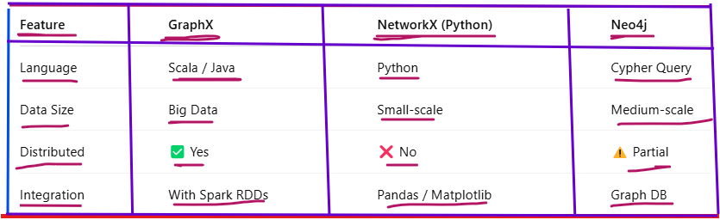
GraphX vs Alternatives

Slide 13
The following programs are written in Scala

Slide 14
Program 1: Create Graph & Display Vertices and Edges.
Problem Statement: Create a small graph of users and their relationships, then display all vertices and edges.
Program Description
Creates 3 people: Amit, Priya, Rahul
Defines relationships (friend, colleague)
Builds graph
Prints all vertices and edges
Output Description
Shows each person with ID
Displays relationships between them
Output
(1,Amit) (2,Priya) (3,Rahul) Edge(1,2,friend) Edge(2,3,colleague)

Slide 15
Program 1: Create Graph & Display Vertices and Edges
import org.apache.spark.graphx._
import org.apache.spark.rdd.RDD
val vertices : RDD[(VertexId, String)] = sc.parallelize(Array(
(1L, "Amit"),
(2L, "Priya"),
(3L, "Rahul")
))
val edges : RDD[Edge[String]] = sc.parallelize(Array(
Edge(1L, 2L, "friend"),
Edge(2L, 3L, "colleague")
))
val graph = Graph(vertices, edges)
// Display vertices
graph.vertices.collect().foreach(println)
// Display edges
graph.edges.collect().foreach(println)
Output
(1,Amit) (2,Priya) (3,Rahul) Edge(1,2,friend) Edge(2,3,colleague)

Slide 16
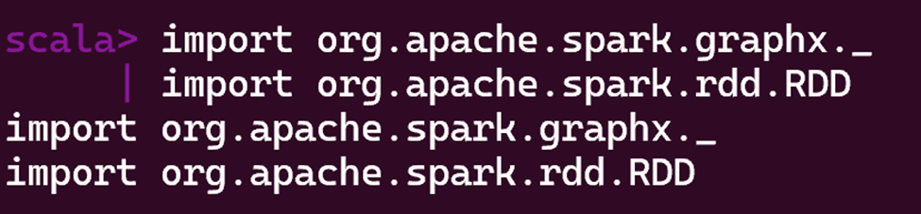

Slide 17
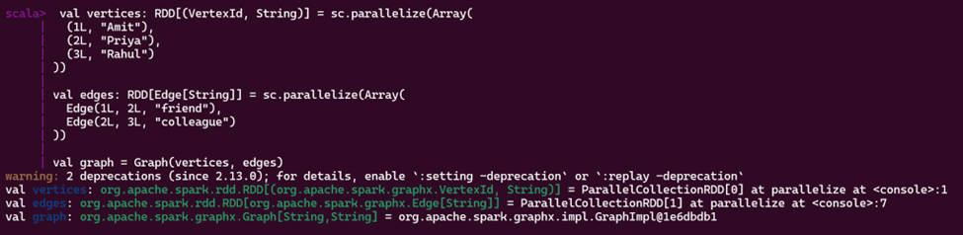
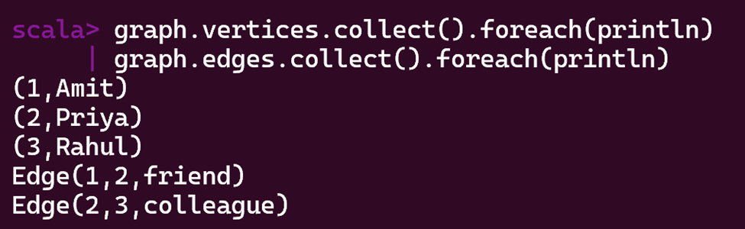
1. Create Graph (Vertices + Edges) 2. Display Vertices and Edges

Slide 18
Program 2: Find Number of Connections
Problem Statement
Calculate how many connections each person has in the graph.
Program
val degrees = graph.degrees
degrees.collect().foreach(println)
Program Description
Uses degrees function
Counts total connections per person
Output:
(1,1)
(2,2)
(3,1)
Output Description
Amit → 1 connection
Priya → 2 connections
Rahul → 1 connection
Priya is most connected
Previous Program Output
(1,Amit) (2,Priya) (3,Rahul)

Slide 19
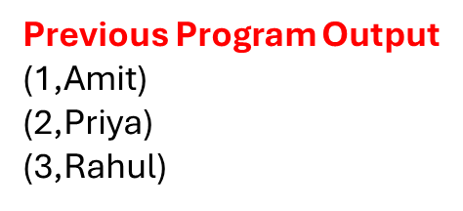
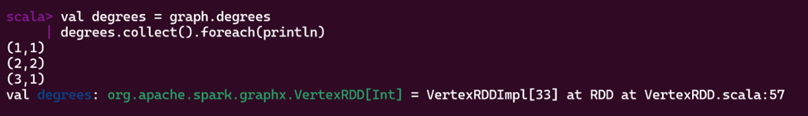
Program 2: Find Number of Connections Degree (Number of Connections)

Slide 20
Program 3: Find Important Person (PageRank)
Output Description
Higher value = more important
Priya has highest rank → most influential
What does 0.0001 mean?
PageRank is an iterative algorithm (it runs multiple times until results stabilize).
After each iteration, GraphX checks: 👉 “How much did the PageRank values change?”
If the change is less than 0.0001, it stops the algorithm.
Alternative Version (Fixed Iterations)
You can also run PageRank with fixed iterations:
graph.pageRank(10)
Here, 10 = number of iterations (not tolerance)
Problem Statement
Identify the most important person using PageRank.
Program
val ranks = graph.pageRank(0.0001).vertices ranks.collect().foreach(println)
Program Description
Applies PageRank algorithm
Assigns importance score to each person
Note:The value 0.0001 is called the tolerance (or convergence threshold).
Output:
(1,0.82) (2,1.30) (3,0.88)
Previous Program Output
(1,Amit) (2,Priya) (3,Rahul)

Slide 21
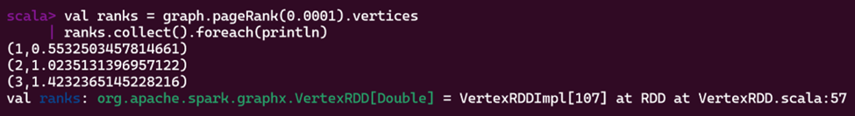
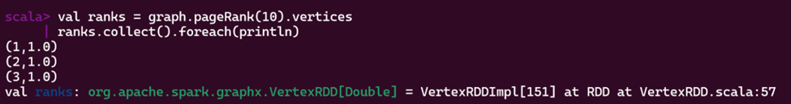
Program 3: Find Important Person (PageRank)
Alternative Version (Fixed Iterations)
Previous Program Output
(1,Amit) (2,Priya) (3,Rahul)

Slide 22
Program 4: Find Connected Components
Problem Statement
Identify groups of people who are connected to each other in a network.
Program Description
Creates 4 people
Connects Amit–Priya–Rahul
Sneha is separate
Finds connected groups
Output
(1,1) (2,1) (3,1) (4,4)
Output Description
(1,2,3) belong to same group → component ID = 1
Sneha is separate → component ID = 4

Slide 23
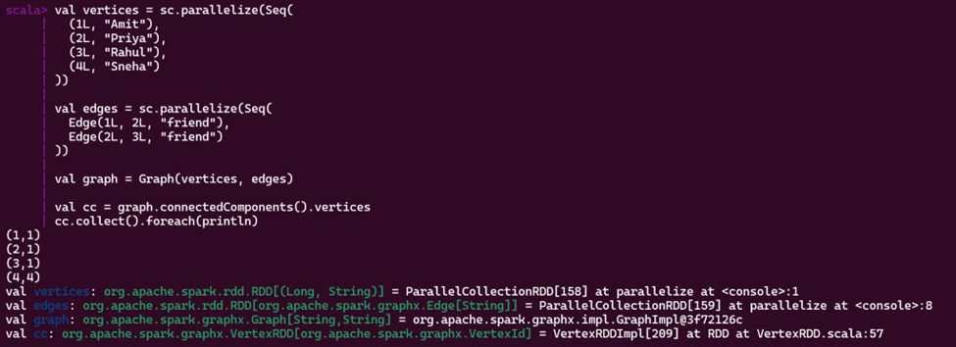
Program 4: Find Connected Components

Slide 24
Program 4: Find Connected Components
Problem Statement
Identify groups of people who are connected to each other in a network.
Program:
val vertices = sc.parallelize(Array( (1L, "Amit"), (2L, "Priya"), (3L, "Rahul"), (4L, "Sneha") ))
val edges = sc.parallelize(Array( Edge(1L, 2L, "friend"), Edge(2L, 3L, "friend") // Sneha is not connected )) val graph = Graph(vertices, edges) val cc = graph.connectedComponents().vertices cc.collect().foreach(println)

Slide 25
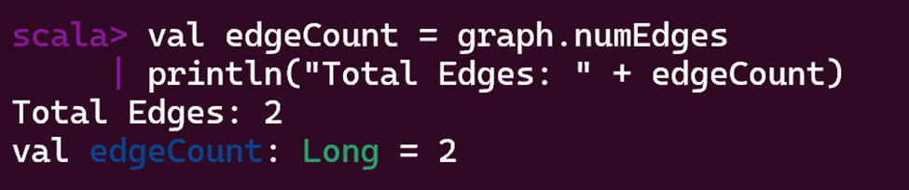
Program 5: Count Total Number of Edges
Problem Statement
Find the total number of relationships in the graph.
Program Description
Uses built-in numEdges property
Counts total connections in graph
Output
Total Edges: 2
Output Description
Graph has 2 relationships
Simple metric to understand graph size
Program
val edgeCount = graph.numEdges println("Total Edges: " + edgeCount)

Slide 26
Program 6: Find Mutual Friends (triangle count)
Problem Statement
Find people who have mutual (common) friends in a social network.
Program Description
Uses triangleCount()
Detects mutual friendships (3 people all connected)
Output
(1,1) (2,1) (3,1) (4,0)
Output Description
Amit, Priya, Rahul form a triangle → mutual friends
Sneha has no mutual group
Previous Program Output(reference)
(1,Amit) (2,Priya) (3,Rahul)
(4,Sneha)

Slide 27
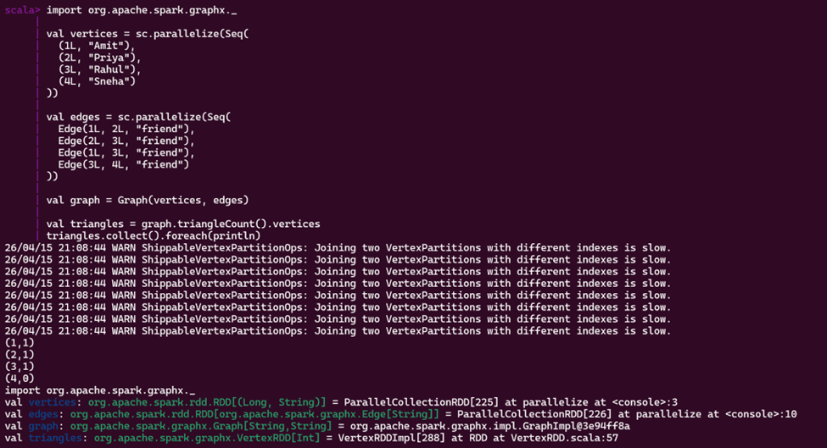
Program 6: Find Mutual Friends (triangle count)

Slide 28
Program 6: Find Mutual Friends (triangle count)
val vertices = sc.parallelize(Array(
(1L, "Amit"),
(2L, "Priya"),
(3L, "Rahul"),
(4L, "Sneha")
))
val edges = sc.parallelize(Array(
Edge(1L, 2L, "friend"),
Edge(2L, 3L, "friend"),
Edge(1L, 3L, "friend"),
Edge(3L, 4L, "friend")
))
val graph = Graph(vertices, edges)
// Find triangles (mutual friendships)
val triangles = graph.triangleCount().vertices
triangles.collect().foreach(println)
Output
(1,1) (2,1) (3,1) (4,0)
Previous Program Output(reference)
(1,Amit) (2,Priya) (3,Rahul)
(4,Sneha)

Slide 29
Program 7: Find Influencer (Highest Degree)
Problem Statement: Find the person with the highest number of connections (most popular).
Program:
val degrees = graph.degrees val maxDegree = degrees.reduce((a, b) => if (a._2 > b._2) a else b) println("Most Influential User: " + maxDegree)
Program Description
Calculates degree of each node
Finds max value using reduce
Output
Most Influential User: (3,3)
Output Description
Rahul has 3 connections → most influential
Useful in social network analysis

Slide 30
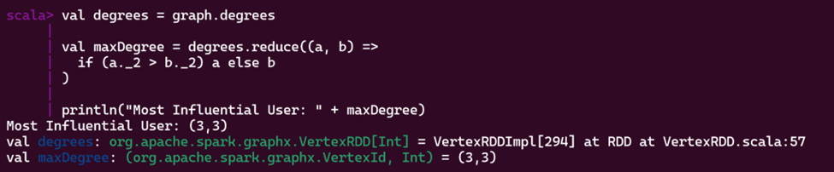
Program 7: Find Influencer (Highest Degree)
Output Description
Rahul has 3 connections → most influential
Useful in social network analysis

Slide 31
Program 8: Suggest Friends (2-Hop Connections)(using triplets)
Program Description
Uses triplets (source, edge, destination)
Helps analyze indirect relationships
Can be extended to build recommendation systems
Output
(Amit,Priya) (Priya,Rahul) (Amit,Rahul) (Rahul,Sneha)
Output Description
Shows direct connections
Can be extended to suggest new friends (e.g., Amit ↔ Sneha via Rahul)
Problem Statement
Suggest new friends based on friends-of-friends.
Program
val triplets = graph.triplets val suggestions = triplets.map(t => (t.srcAttr, t.dstAttr)) suggestions.collect().foreach(println)

Slide 32
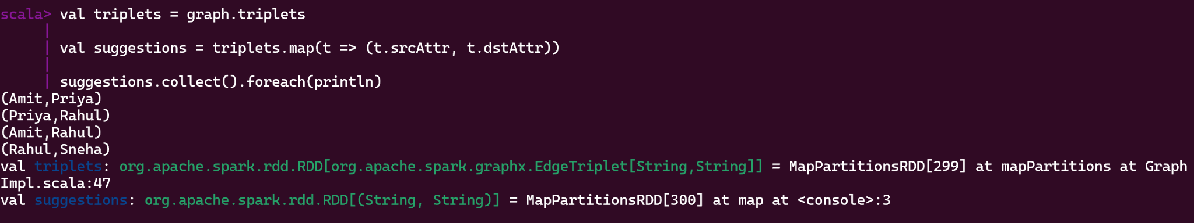
Program 8: Suggest Friends (2-Hop Connections)(using triplets)
Shows direct connections
Can be extended to suggest new friends (e.g., Amit ↔ Sneha via Rahul)

Slide 33
Best Practice Tips
Use triplets to access both edge and vertex data.
Always cache your graph if reused.
Use partitioning strategies to scale.
Combine GraphX with Spark SQL and DataFrames for hybrid analysis.

Slide 34
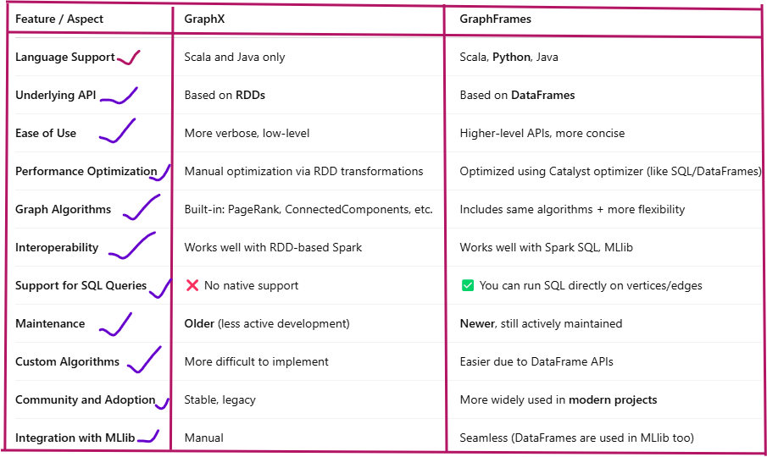
GraphX vs GraphFrames

Slide 35
When to Use What?
✔️ Use GraphX if:
You're working in Scala only
You need lower-level control over partitioning and RDD transformations
You're working on legacy Spark 1.x/2.x projects
✔️ Use GraphFrames if:
You prefer working in Python or PySpark
You need SQL + graph hybrid queries
You want easier syntax and Catalyst optimization
You're working on a modern data pipeline (with Spark SQL, MLlib, etc.)

Slide 36
Final Recommendation (But our syllabus has GraphX)
For modern Spark applications, especially those using Python, DataFrames, or MLlib, go with GraphFrames.
If you're working in Scala, need fine-grained control, or maintaining an older system — stick with GraphX.

Slide 37
GraphX and Structured Data
Apache Spark's GraphX is a graph computation engine built on top of RDDs (Resilient Distributed Datasets) — which means GraphX is not natively structured.
However, it does support structured-like concepts using case classes and RDD schemas.

Slide 38
What does "structured data" mean in Spark?
Structured data means data that has a schema —
for example:
A table with columns: id, name, age
A DataFrame or SQL Table
Something you can query with SQL or apply columnar operations to
GraphX does not use Spark SQL or DataFrames internally —
it uses RDDs of vertices and edges like this:

Slide 39
Example: GraphX with Structured Data (in Scala)
// Create edges RDD: source -> destination
val edges: RDD[Edge[String]] = sc.parallelize(Seq(
Edge(1L, 2L, "friend"),
Edge(2L, 3L, "colleague")
))
// Build the graph
val graph = Graph(vertices, edges)
// Print structure
graph.vertices.collect.foreach(println)
graph.edges.collect.foreach(println)
// Import
import org.apache.spark.graphx._
import org.apache.spark.rdd.RDD
// Create vertices RDD with schema: (id, name)
val vertices: RDD[(VertexId, (String, String))] = sc.parallelize(Seq(
(1L, ("Alice", "Student")),
(2L, ("Bob", "Engineer")),
(3L, ("Charlie", "Scientist"))
))

Slide 40
import org.apache.spark.graphx._
import org.apache.spark.rdd.RDD
These imports allow us to:Use GraphX APIs like Graph, Edge, VertexId, etc.Use RDDs, which are the core of how GraphX stores graph data.
2. Define the Vertices
We are creating a list of vertices using a tuple format:scala
(VertexId, (name, role))
Example:1L is the unique ID for vertex Alice"Alice" is the name"Student" is her role
This list is converted into an RDD using sc.parallelize(), which makes it distributed and usable by Spark.

Slide 41
What is an Edge?
An edge in GraphX connects two vertices:
Edge(sourceVertexId, destinationVertexId, relationship)
Edge(1L, 2L, "friend") means Alice is a friend of Bob.
Edge(2L, 3L, "colleague") means Bob is a colleague of Charlie.

Slide 42
Build the Graph
val graph = Graph(vertices, edges)
This creates a Graph object using the vertices and edges defined earlier.Now graph is a directed graph, meaning:
From Alice → Bob (friend)
From Bob → Charlie (colleague)

Slide 43
Explore the Graph
graph.vertices.collect.foreach(println)
(1,(Alice,Student))
(2,(Bob,Engineer))
(3,(Charlie,Scientist))
Print all edges:
graph.edges.collect.foreach(println)
Edge(1,2,friend)
Edge(2,3,colleague)

Slide 44
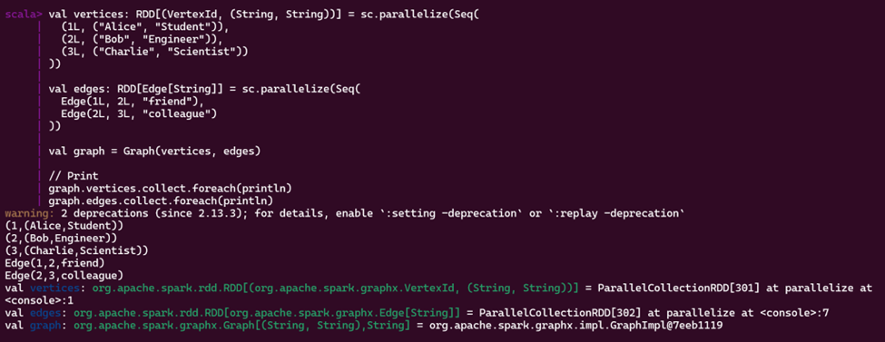
11. Structured Data Graph

